Slide 1
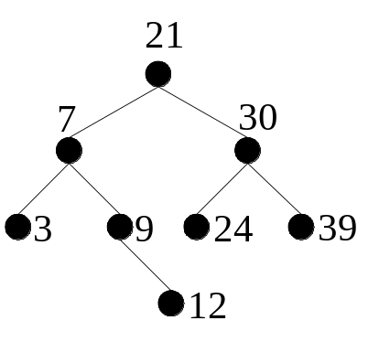
Binary Search Trees
Ordered Tree
InsertItem
Recap
Simple Recursion
introduced trees and associated terminology;
developed a tree node Class and a binary tree Class.
Use recursion to implement Traversal techniques, e.g. InOrder
Aims
Develop a Binary Search Tree Class
  inheriting from Binary Tree Class
Implementation of more complex recursive tree methods
Built nodes manually
No insert method

Slide 2
Binary Search Trees
A Binary Search Tree (BSTree) is a binary tree where the values associated with nodes are ordered such that:
  the value associated with the root is greater than all values in the left sub-tree.
  the value associated with the root is less than all values in the right sub-tree.
  the left sub-tree and right sub-tree are also BSTrees.

Slide 3
Implementing the BSTree
Methods needed to :
create a new BSTree. (constructor)
insert an item into the tree.
remove an item from the tree.
display the properties of the tree.
  Height, NumberOfNodes etc.
Use BinTree’s in-order traversal.
class BSTree<T> : BinTree<T> where T:IComparable
{
//protected Node<T> root, declared in BinTree
public BSTree()
{
root = null;
}
public void InsertItem(T item)
{
insertItem(item, ref root);
}
private void insertItem(T item, ref Node<T> tree)
{
}
}
protected – allows
inheriting class,
access to root

Slide 4
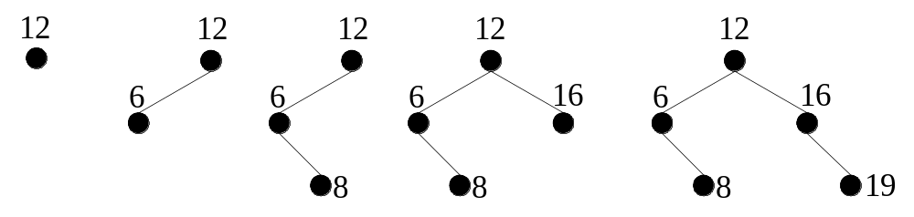
Inserting An Item
Inserting an item always takes place at a leaf. Consider the tree below, built by inserting [12, 6, 8, 16, 19] in that order.
Insert algorithm needs to construct a new leaf node in the correct location.
Pass the subTree reference by “ref”, allowing the change to happen

Slide 5
Insert Item
8
Left
Right
inserting a 6
6
Left
Right
insertItem(item, ref tree) Algorithm
if tree is empty
tree = new node with item as its root
else if item < root(tree)
insert item in Left Sub Tree of tree
else if item > root(t)
insert item in Right Sub Tree of tree
else
do nothing : item is already present
end if
private void insertItem(T item , ref Node<T> tree)
{
if ( tree == null )
tree = new Node<T>(item);
else if ( item.CompareTo( tree.Data )< 0 )
insertItem( item, ref tree.Left );
else if ( item.CompareTo( tree.Data ) >0 )
insertItem( item, ref tree.Right );
}
public void InsertItem (T item)
{ insertItem( item, ref root ); }

Slide 6
Example 5,3,4
1
private void insertItem(T item , ref Node<T> tree)
{
if ( tree == null )
tree = new Node<T>(item);
else if ( item.CompareTo( tree.Data )< 0 )
insertItem( item, ref tree.Left );
else if ( item.CompareTo( tree.Data ) >0 )
insertItem( item, ref tree.Right );
}
public void InsertItem (T item)
{ insertItem( item, ref root ); }
tree
5
5

Slide 7
Example 5,3,4
1
1.
private void insertItem(T item , ref Node<T> tree)
{
if ( tree == null )
tree = new Node<T>(item);
else if ( item.CompareTo( tree.Data )< 0 )
insertItem( item, ref tree.Left );
else if ( item.CompareTo( tree.Data ) >0 )
insertItem( item, ref tree.Right );
}
public void InsertItem (T item)
{ insertItem( item, ref root ); }
tree
2.
private void insertItem(T item , ref Node<T> tree)
{
if ( tree == null )
tree = new Node<T>(item);
else if ( item.CompareTo( tree.Data )< 0 )
insertItem( item, ref tree.Left );
else if ( item.CompareTo( tree.Data ) >0 )
insertItem( item, ref tree.Right );
}
tree
3
5
5
3
2
3
5
tree
3

Slide 8
Example 5,3,4
1
2
1.
private void insertItem(T item , ref Node<T> tree)
{
if ( tree == null )
tree = new Node<T>(item);
else if ( item.CompareTo( tree.Data )< 0 )
insertItem( item, ref tree.Left );
else if ( item.CompareTo( tree.Data ) >0 )
insertItem( item, ref tree.Right );
}
public void InsertItem (T item)
{ insertItem( item, ref root ); }
4
4
tree
5
2.
private void insertItem(T item , ref Node<T> tree)
{
if ( tree == null )
tree = new Node<T>(item);
else if ( item.CompareTo( tree.Data )< 0 )
insertItem( item, ref tree.Left );
else if ( item.CompareTo( tree.Data ) >0 )
insertItem( item, ref tree.Right );
}
public void InsertItem (T item)
{ insertItem( item, ref root ); }
3.
private void insertItem(T item , ref Node<T> tree)
{
if ( tree == null )
tree = new Node<T>(item);
else if ( item.CompareTo( tree.Data )< 0 )
insertItem( item, ref tree.Left );
else if ( item.CompareTo( tree.Data ) >0 )
insertItem( item, ref tree.Right );
}
5
tree
3
3
3
5
4
5
tree
3
3
tree
4
4

Slide 9
Example 5,3,4
1
tree
tree
4
1.
private void insertItem(T item , ref Node<T> tree)
{
if ( tree == null )
tree = new Node<T>(item);
else if ( item.CompareTo( tree.Data )< 0 )
insertItem( item, ref tree.Left );
else if ( item.CompareTo( tree.Data ) >0 )
insertItem( item, ref tree.Right );
}
public void InsertItem (T item)
{ insertItem( item, ref root ); }
5
5
3
3
4
2
4
5
tree
3
4

Slide 10
Height
tree
tree
null
Longest path in the tree
What’s the recursive algorithm?
Usually if statement – so what cases are there?
Greater – write a max function int max(int x, int y)
Case | Return
Tree empty | 0
Not empty | 1 + greater of (height of Left or height of Right)

Slide 11
Summary
Introduced Binary Search Tree
Implemented insertItem
Constructed a Binary Search Tree

